Slide 1
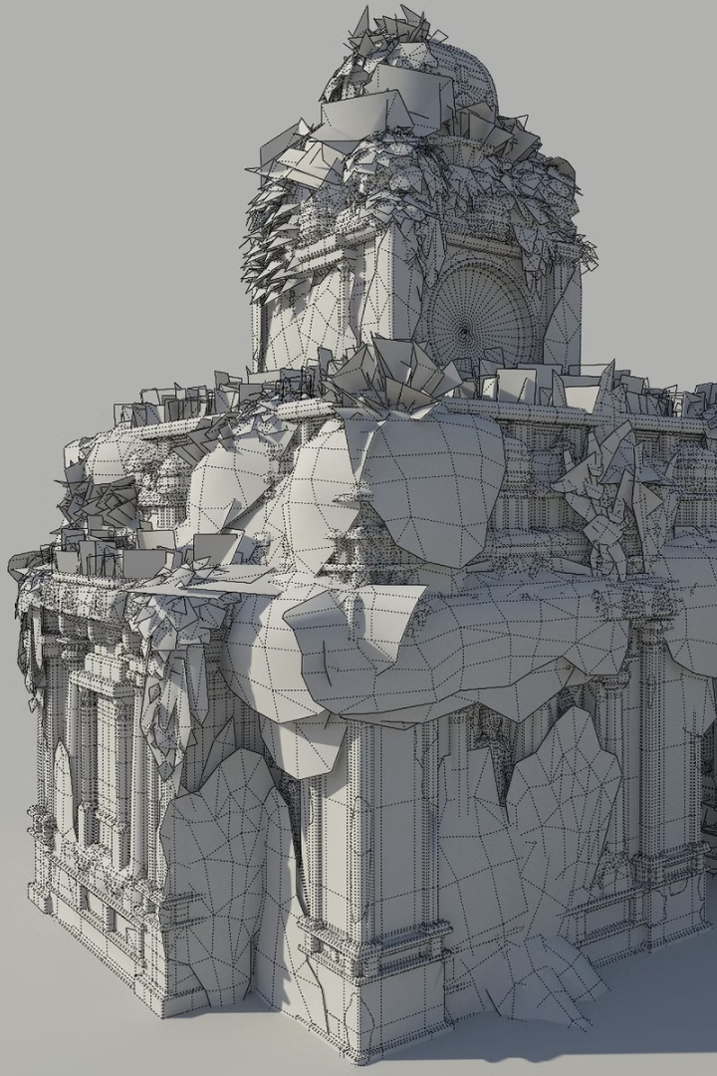

Introduction to Retopology and UV Unwrapping in Blender
Retopology is the art of rebuilding a 3D model with cleaner geometry. UV unwrapping involves flattening 3D surfaces onto 2D space for texturing.
Both processes are crucial for optimising high-poly models for games, animation or rendering. Blender offers powerful tools to streamline these complex tasks.
by Rob Blofield

Slide 2
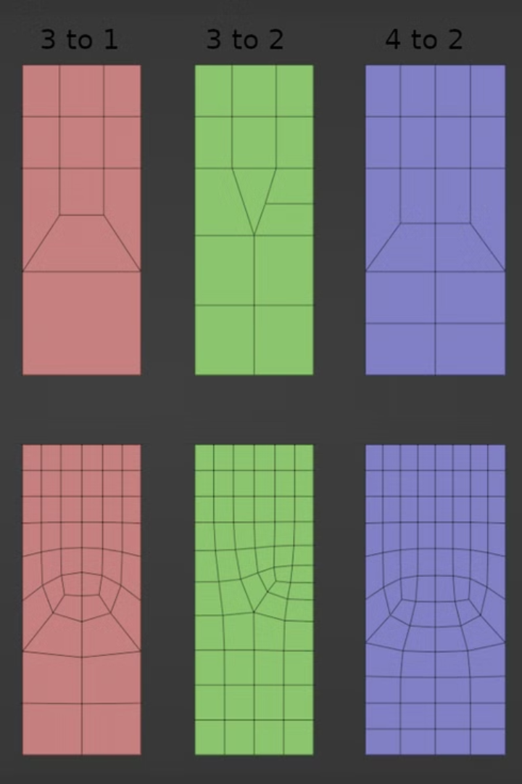
Understanding Retopology
1
Purpose
2
Key Principles
Retopology creates a clean, animation-friendly mesh from detailed sculpts. It reduces complexity while preserving essential details.
Focus on quad-based geometry. Follow natural contours. Concentrate detail where needed. Reduce poly count strategically.
3
Blender Tools
Leverage Shrinkwrap modifier to snap new topology to original. Use F2 add-on for faster quad creation.

Slide 3
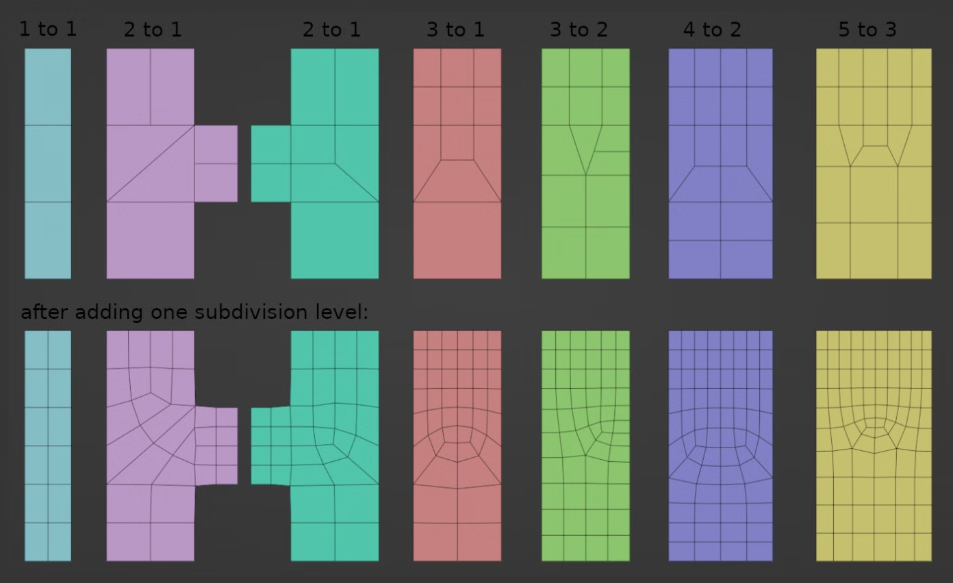

Slide 4
UV Unwrapping Basics
What Are UVs?
Why They Matter
Projection Types
UVs translate 3D coordinates to 2D space. Think of unwrapping as carefully peeling and flattening the skin of your model.
Proper UVs enable accurate texturing. They prevent stretching and ensure detail appears where intended.
Smart UV Project works for complex objects. Cylinder and Sphere projections suit rounded shapes. Proper seam placement is crucial.

Slide 5
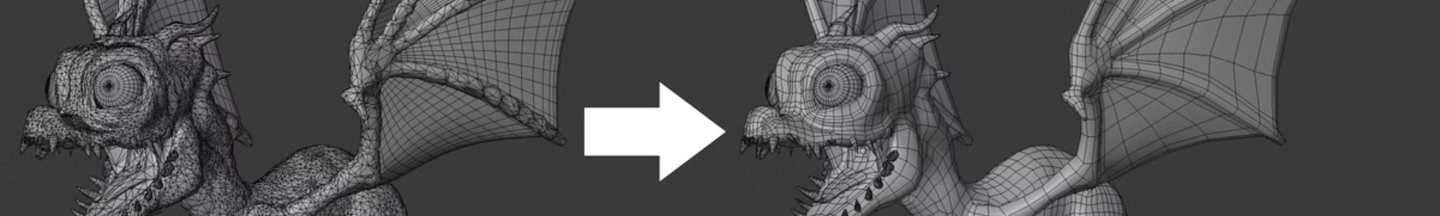
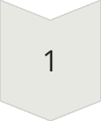
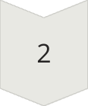
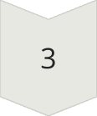
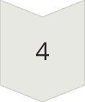
Retopology Workflow in Blender
High-Poly Preparation
Import or sculpt your high-poly model. Ensure it's clean without internal geometry. Set up proper lighting to see details.
Manual Mesh Creation
Create a new mesh object. Enable snap to face with Project option. Build edge loops following natural contours.
Refinement
Add supporting edge loops. Maintain quad topology. Ensure even distribution of polygons based on deformation needs.
Verification
Check silhouette preservation. Test with subdivision surface. Ensure edge flow supports animation deformation.

Slide 6

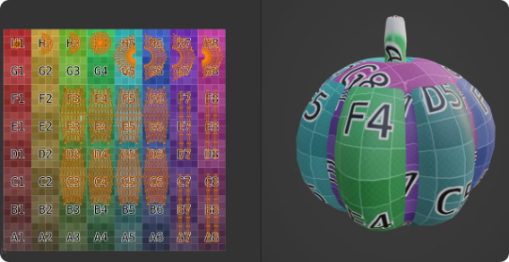
UV Unwrapping Techniques
Mark Strategic Seams
Place seams in hidden areas. Follow natural breaks in the model. Consider how textures will flow across surfaces.
Unwrap and Check
Select all and unwrap. Apply checker texture. Look for stretching and distortion. Adjust seams as needed.
Optimise UV Layout
Pack islands efficiently. Scale islands based on visibility. Align islands to grid for easier texturing.

Slide 7
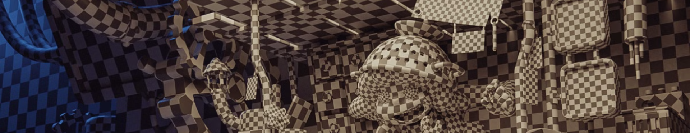
Best Practices and Conclusion
Topology for Animation
UV Efficiency
Next Steps
Place edge loops around joints and facial features. Create topology that deforms naturally. Balance detail with performance needs.
Maximise texture space usage. Mirror symmetrical parts when possible. Group similar materials into texture atlases.
Export for texturing in specialized software. Consider normal map baking to transfer high-poly details. Prepare for rigging and animation.

